Slide 1
Two Factor Authentication
Hüseyin Tosun && Berkan Dinar && M. Habib Beyatlı

Slide 2

Project
A mobile application that uses two factor authentification
User entered password and recognized user face

Slide 3
Simple and Useful
Enter a username and password to sign up page
Led the app restore your face looking
Sign in to application with the same way

Slide 4
Technologies and Tools
Development Environment: Android Studio
Programming Language : Java
Frontend: XML
Deployment Platform : General Mobile 5 / Android 7.1.1 version
Source for Face Recognition Library: Github [1]
[1] sladomic. (2017, 10 14). Android Face Recognition with Deep Learning Test Framework. Retrieved from github: https://github.com/Qualeams/Android-Face-Recognition-with-Deep-Learning-Test-Framework

Slide 5
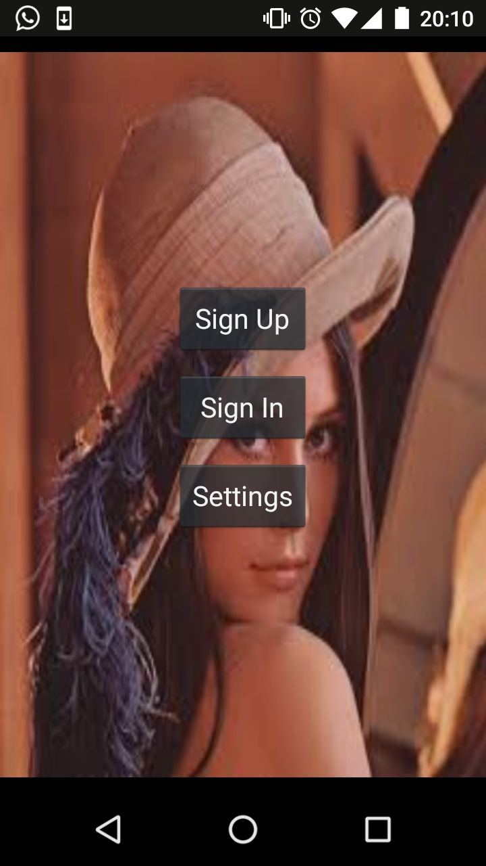
User Interface
Main Page
Sign Up Page
Sign In Page
Welcome Page

Slide 6
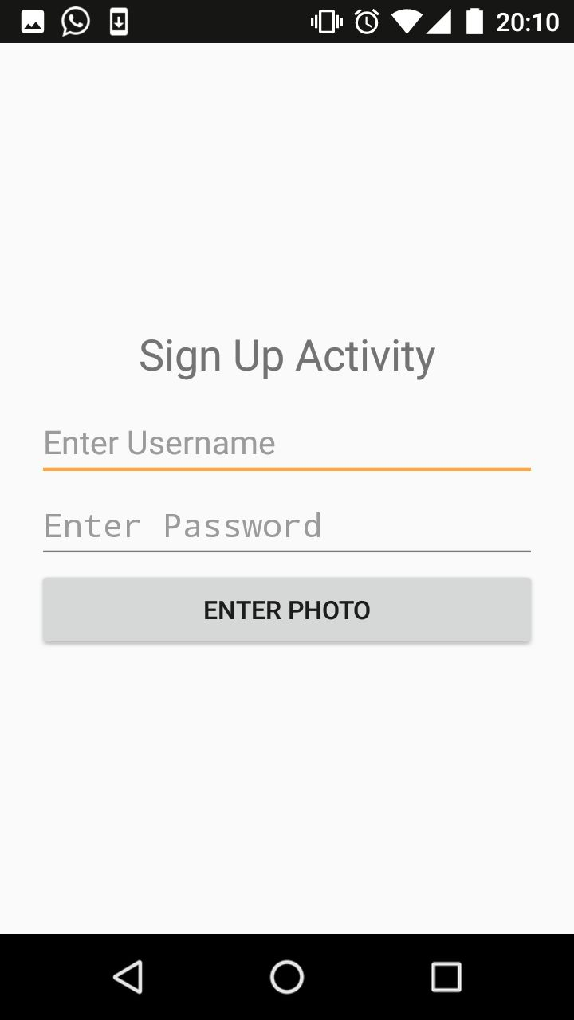
Sign Up Page
Username and password entry
Face detection and training operations

Slide 7
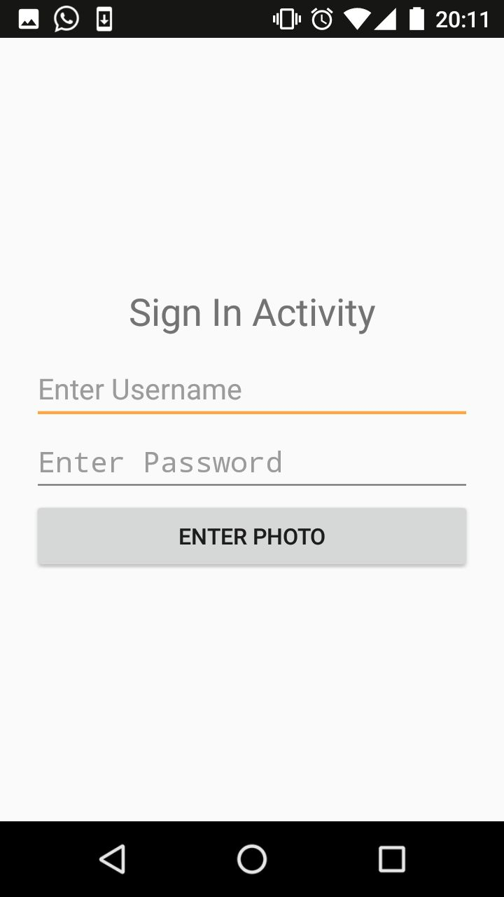
Sign In Page
Username and password entry
Recognition and authentication operations

Slide 8
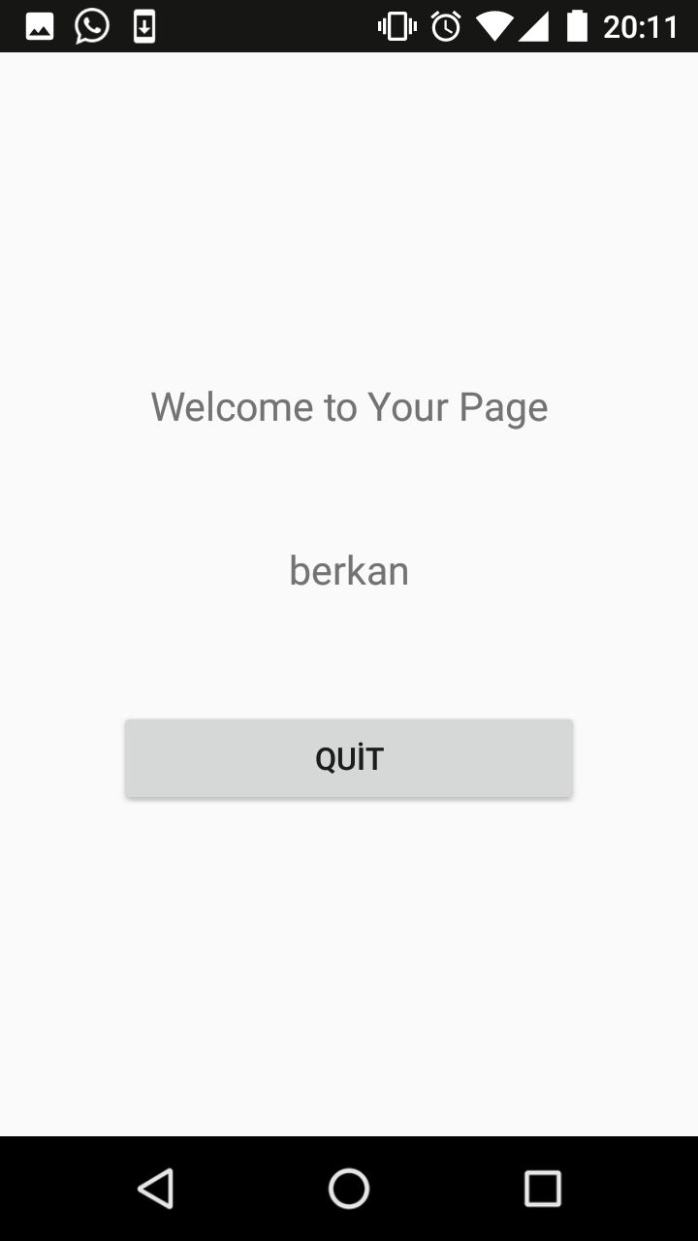
Welcome Page
Personal page of user

Slide 9


Slide 10


Slide 11
